Slide 1
Sudoku Game
Project Report - Computer Engineering (B.Tech)
Dharmsinh Desai University (DDU)
Team Members:
Piyush Jitendrakumar Desai | Roll No: CE069 | ID: 24CEUOS026
Mihir Sarjubhai Bhanvadiya | Roll No: CE061 | ID: 24CEUOS011
PPS Project

Slide 2

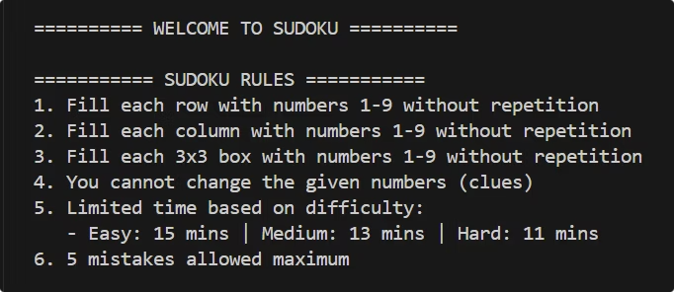
Project Overview
Classic 9x9 Sudoku
C++ Console Application
Key Features
Dynamic Board Display
Difficulty Levels: Easy, Medium, Hard
⌛ Timer & ↩️ Undo Move
Mistake Tracking
Scroll Effect using our header file

Slide 3

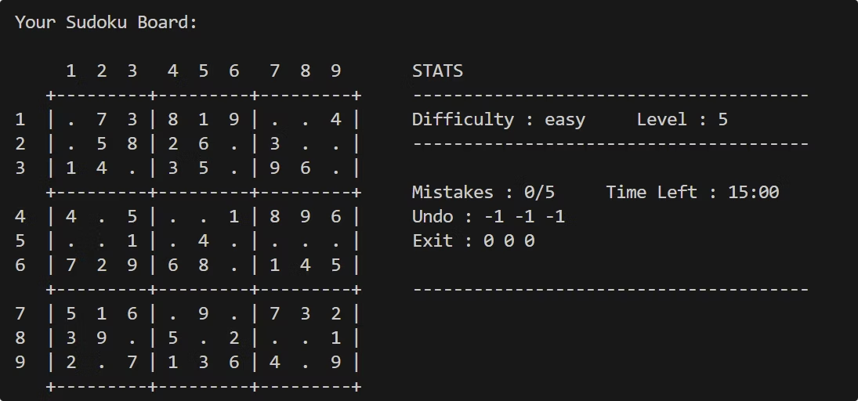
Special Features
Scroll Effect
Animated "SUDOKU" banner
Timer
Real-time MM:SS format
Undo Move
No restart needed and can undo step

Slide 4
OOP Concepts Used
Hierarchical Inheritance
Abstract Classes and Pure Virtual Functions
The Easy, Medium, and Hard classes inherit from the Sudoku class.
The Sudoku class is an abstract class with a pure virtual function getSudoku().
They implement the getSudoku() method to provide specific puzzles for each difficulty level.
This enforces that derived classes (Easy, Medium, Hard) must implement this function.
class Easy : public Sudoku { … };
virtual vector<vector<int>> getSudoku() = 0;
class Medium : public Sudoku { … };
class Hard : public Sudoku { … };
PPS Project

Slide 5
OOP Concepts Used
Polymorphism (Dynamic Binding)
Constructor and Initialization List
The playGame function uses a pointer of type Sudoku to call methods on derived classes.
The constructors of the Sudoku class and its derived classes use initialization lists to initialize member variables.
This allows for dynamic binding, where the correct method is called based on the actual object type at runtime.
For example, the Sudoku constructor initializes level, difficulty, and mistakeCount using an initialization list:
The function playGame(Sudoku* game) takes a pointer to the base class and calls derived class methods.
Sudoku(string diff, int lvl, int mistake = 0) : level(lvl), difficulty(diff), mistakeCount(mistake) {};
Sudoku* game = nullptr;
…
File Handling
if (diff=="easy") game = new Easy(lvl);
ifstream file("easy.txt"); --> Opens the file and prepares to read puzzles line by line.
else if (diff=="medium") game = new Medium(lvl);
else game = new Hard(lvl);
file.ignore(numeric_limits<streamsize>::max(), '\n'); --> Clears the remaining part of the current line after reading a board o skip blank lines or garbage after one puzzle, before reading the next.
playGame(game);
file.close() --> Releases the file stream once reading is done
PPS Project

Slide 6
OOP Concepts Used
Making our own header file
Timer <chrono>
#define Defines a symbolic constant or macro — in this case, a unique name.
The <chrono> library is used to implement a timer for the game.
It tracks the time taken by the player to solve the Sudoku puzzle.
#ifndef “If not defined” — checks if the symbol hasn’t been defined yet.
auto startTime = steady_clock::now(); --> now() returns time_point form monotic clock of chrono::steady_clock
#endif — Ends the conditional started by #ifndef.
int timePassed = duration_cast<seconds>(now - startTime).count(); --> count() returns numeric value of time in seconds
int timeLeft = totalMinutes * 60 - timePassed;
PPS Project

Slide 7





Flow of Program
Start & Scroll Effect
Display Rules & Select Difficulty
Load Puzzle & Start Timer
Game Loop
Check undo/Exit
Check Validate Move
Update Board
Display updated board
Win/Game Over & Replay?

Slide 8
Team Contributions
Piyush Desai
Mihir Bhanvadiya
Core Game Logic
Scroll Animation (ScrollEffect.h)
Timer Implementation
UI/UX Design
Debugging & Optimization
Board Management

